Slide 1
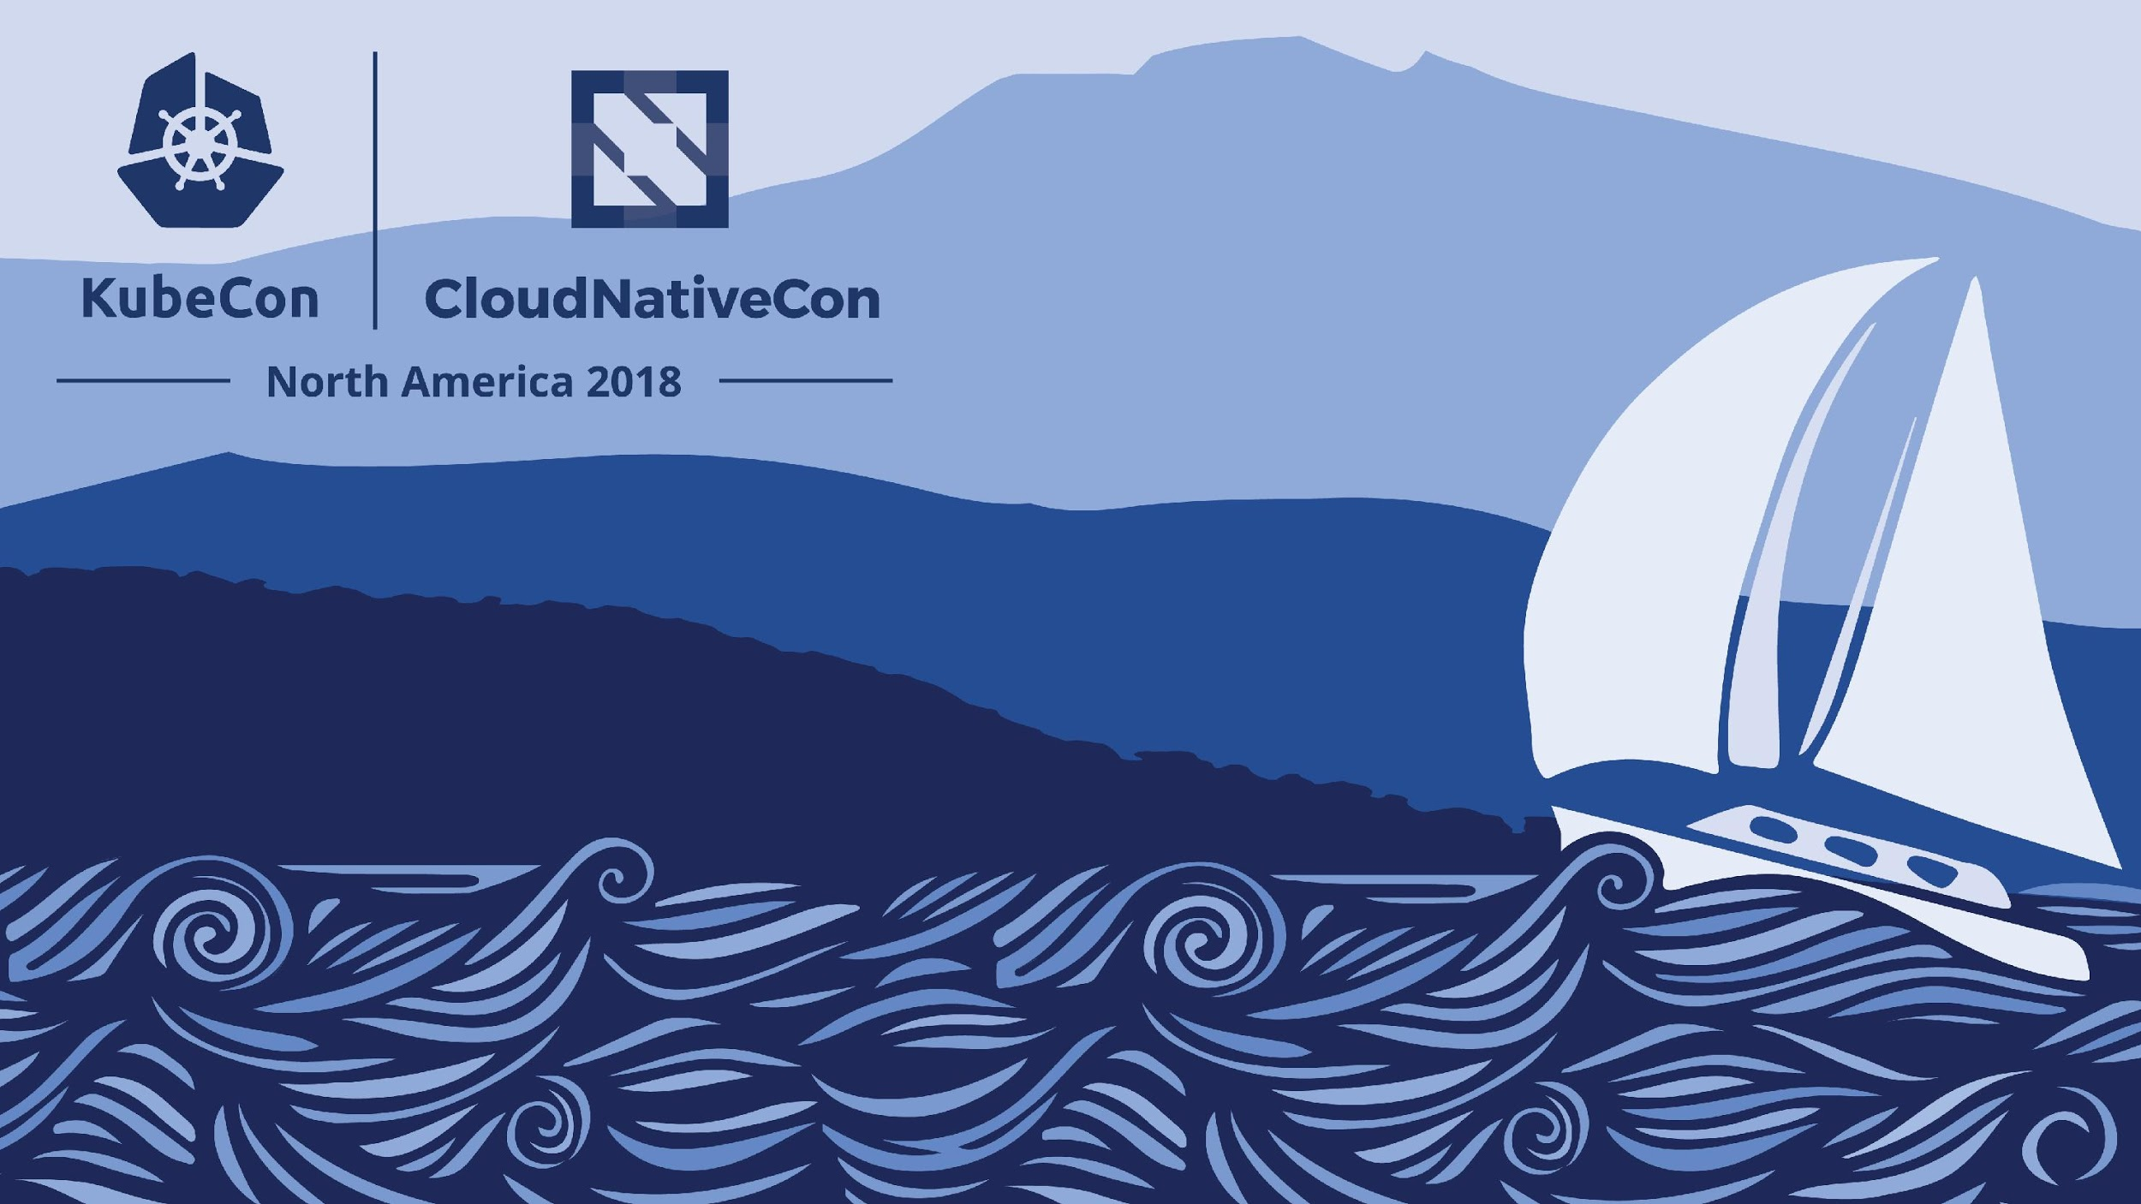
Failure is always an Option

Slide 2
Who Are We
Sugu Sougoumarane
CTO of Planetscale
Co-Founder of Vitess
sugu@planetscale.com
Daniel Kozlowski
Minister of Engineering At Planetscale
koz@planetscale.com

Slide 3
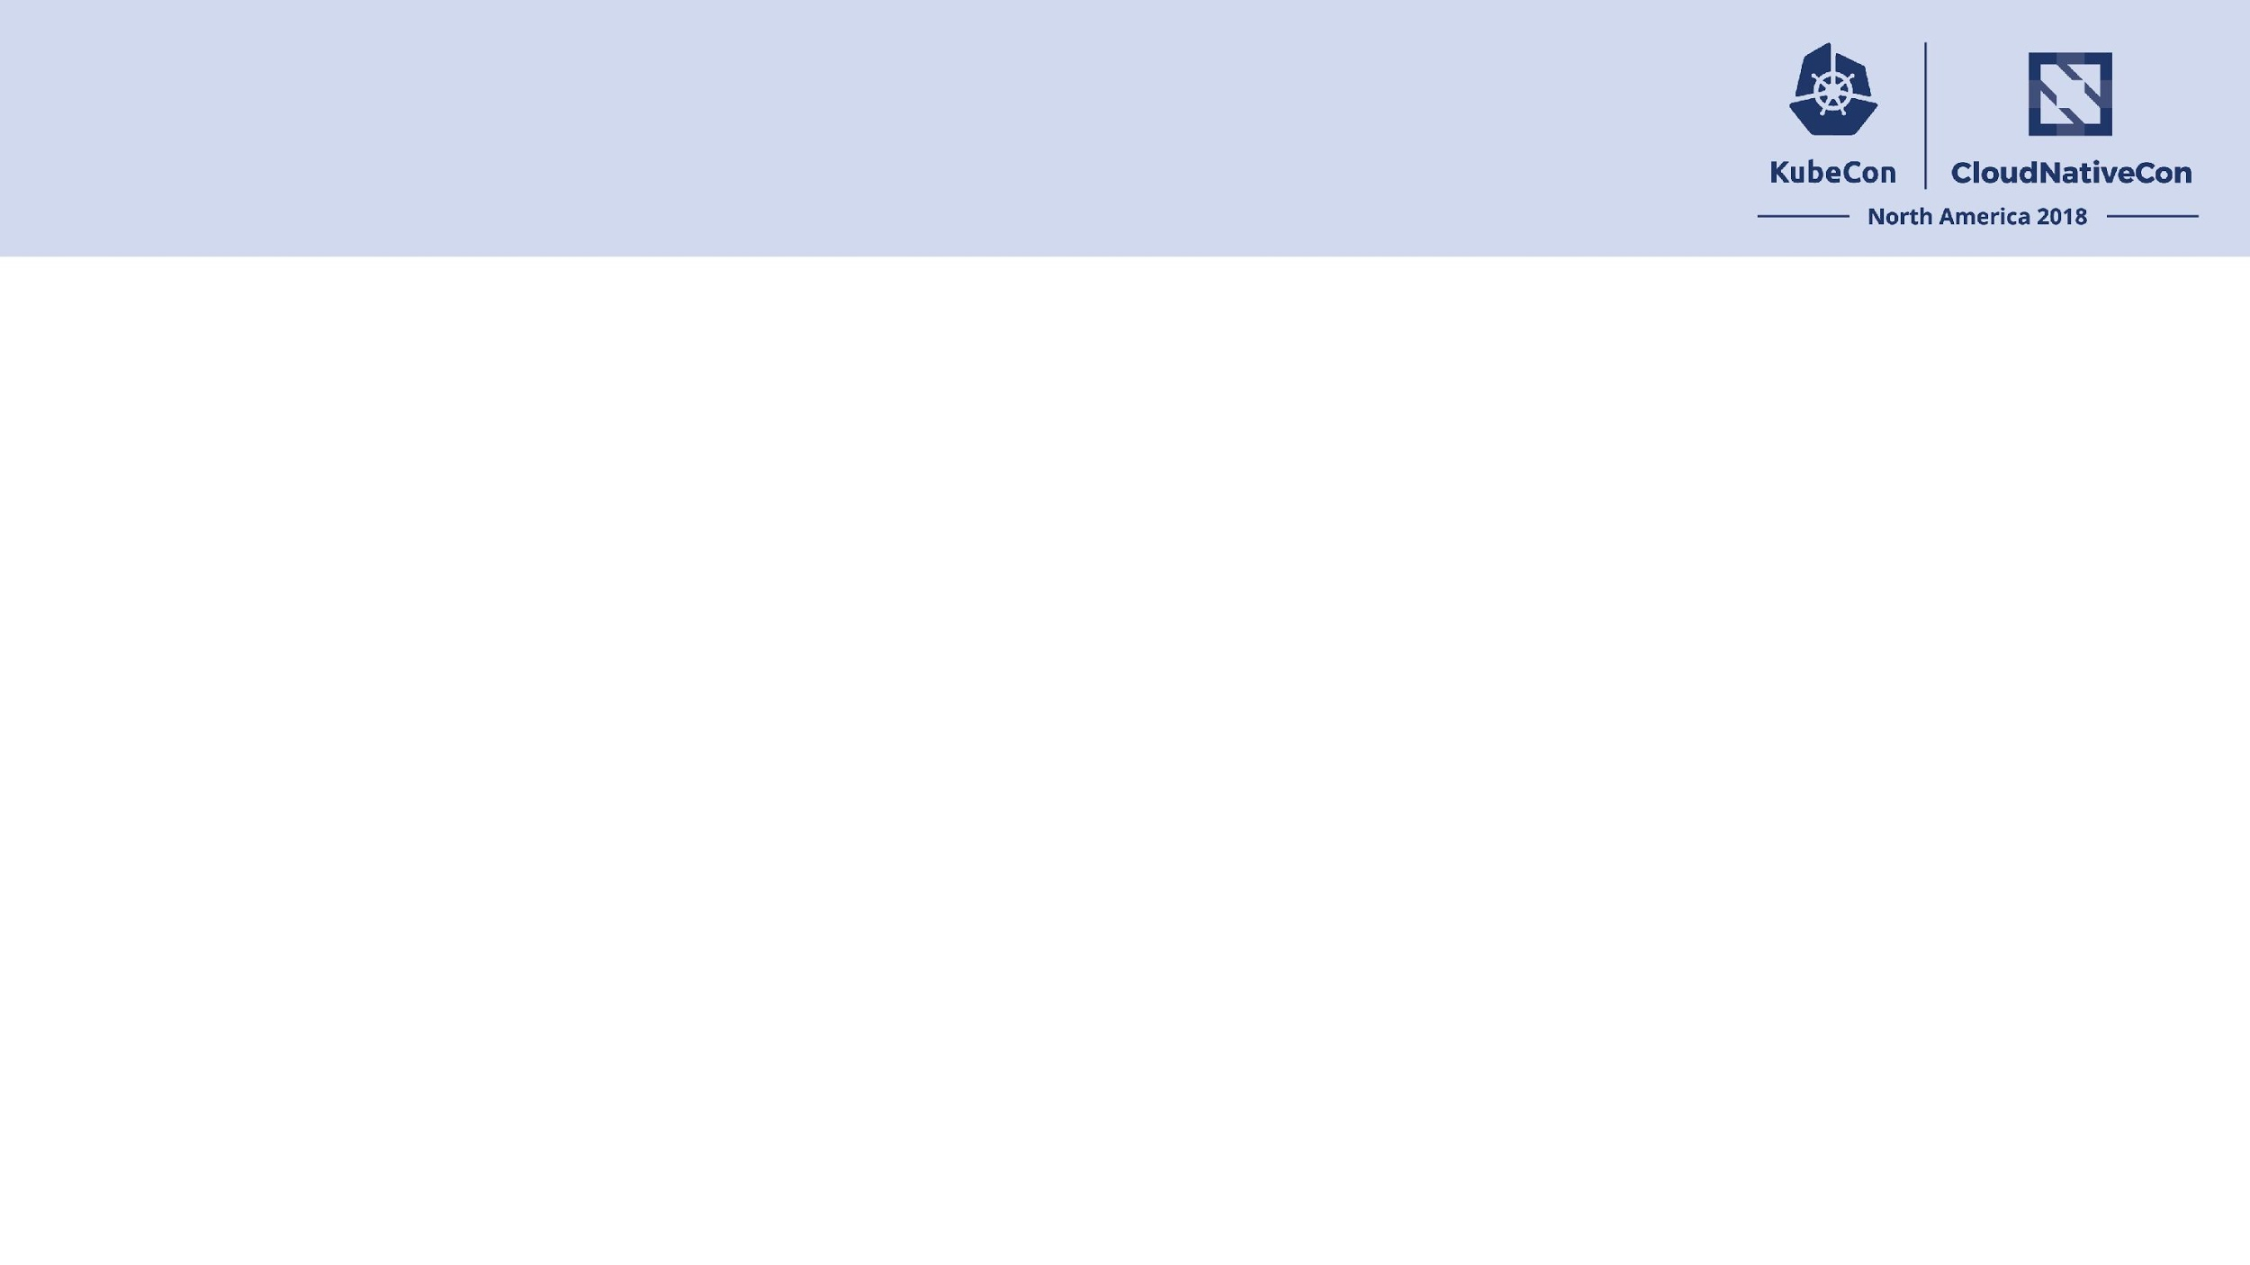
Failure Deep Dive
Failure is a part of Life
You can Handle Failure or you can propagate Failure
To be Cloud Native you must handle Failures at any point in the Stack
Vitess Has many Features to handle Failures

Slide 4
Preparing Vitess to Fail
Placing Things Correctly to handle failure
Knowing How to Recover
Knowing How much Risk you can Accept

Slide 5
How Vitess Handles Failure
Separation of Components
Entrypoint covers some failures
Tablet Covers Some failures
Duplication covers some failures
Push State to the Edges
Into the Application Client
Into the Database

Slide 6
Failure and Recovery
Vtctld
Not In Serving Path
Vtgate
Clients will drop connection
Vttablet
Transactions will fail
MySQL

Slide 7
Failure and Recovery
Single Node
Chosen At Random
Effects depend on exact node chosen

Slide 8
Failure and Recovery
Entire Datacenter
Failing Over an Entire deployment
Easier than single node……
Unless it isn’t

Slide 9
Failure and Recovery
Network Partitions
Worst kind of failure
Can look like Single Node or Datacenter
Might not even be a failure
Configuration mishaps can look a lot like partitions
Might be in a field somewhere under some soybeans

Slide 10

Join the Vitess Community
Vitess.io
https://vitess.slack.com
https://github.com/vitessio/vitess
planetscale.com
careers@planetscale.com

Slide 11
